Slide 1
Theory of production

Slide 2
Resource Payments:
Workers/labors are paid a wage
Land resources are paid for with rent.
Capital resources are paid for with interest because businesses generally take out loans to purchase physical capital and the interest rate is a primary factor in determining how much physical capital is purchased .

Slide 3
Derived Demand: The demand for resources is directly related to the demand for the products produced by those resources. As a result it is said that the demand for resources is a derived demand. That means if the demand for houses increases, the demand for construction workers will also increase. If the demand for corn increase, the demand for farmland to grow corn will increase. The reason for that derived demand comes from changes in product demand causing changes in a resource’s marginal revenue product.
When the demand for a product is tied to the purchase of some parent product, it is called derived or induced demand.
Example – all raw materials
Autonomous Demand

Slide 4
There are two types of resources
Fixed resources – Fixed resources are fixed. They don’t change as you produce more.
Variable resources – Variable resources do change with the more that you produce.
When it comes to producing things economists like to differentiate between the short run and long run.
A company is in short-run when they have at least one fixed resources .
Long run is more about what could potentially happen in the future. So in long run all resources are variable.

Slide 5
Law of diminishing marginal returns
The law of diminishing marginal utility states that all else equal, as consumption increases, the marginal utility derived from each additional unit declines. Marginal utility is the incremental increase in utility that results from the consumption of one additional unit. "Utility" is an economic term used to represent satisfaction or happiness.

Slide 6
Total cost
Total cost (TC) is the sum of all costs incurred by a company in the process of producing a certain level of output.
Total cost is typically expressed as the combination of all fixed costs (FC) and variable costs (VC)

Slide 7
Fixed costs
fixed costs – costs that do not change with the level of output.
Fixed costs are the same at all levels of output (even when production equals zero).
Examples:
Amortization
Insurance
Interest expense
Rent

Slide 8
Variable costs
variable costs – costs that change with the level of output (variable costs = 0 when production is zero)
Examples:
wages,
utilities,
materials used in production

Slide 9
Example
Q | FC | VC | TC
0 | 50 | 0 | 50
1 | 50 | 10 | 60
2 | 50 | 30 | 80
3 | 50 | 60 | 110
4 | 50 | 110 | 160
5 | 50 | 180 | 230
6 | 50 | 280 | 330
7 | 50 | 400 | 450
8 | 50 | 550 | 600
9 | 50 | 720 | 770
10 | 50 | 900 | 950

Slide 10
Fixed costs do not vary with the quantity of output

Slide 11
Variable costs

Slide 12
TC, TVC, and TFC

Slide 13
Average fixed cost
Average fixed cost (AFC) = TFC / Q
Q | FC | VC | TC | AFC
0 | 50 | 0 | 50
1 | 50 | 10 | 60 | 50,0
2 | 50 | 30 | 80 | 25,0
3 | 50 | 60 | 110 | 16,7
4 | 50 | 110 | 160 | 12,5
5 | 50 | 180 | 230 | 10,0
6 | 50 | 280 | 330 | 8,3
7 | 50 | 400 | 450 | 7,1
8 | 50 | 550 | 600 | 6,3
9 | 50 | 720 | 770 | 5,6
10 | 50 | 900 | 950 | 5,0

Slide 14
Average variable cost
Average variable cost (AVC) = TVC / Q
Q | FC | VC | TC | AFC | AVC
0 | 50 | 0 | 50
1 | 50 | 10 | 60 | 50,0 | 10,0
2 | 50 | 30 | 80 | 25,0 | 15,0
3 | 50 | 60 | 110 | 16,7 | 20,0
4 | 50 | 110 | 160 | 12,5 | 27,5
5 | 50 | 180 | 230 | 10,0 | 36,0
6 | 50 | 280 | 330 | 8,3 | 46,7
7 | 50 | 400 | 450 | 7,1 | 57,1
8 | 50 | 550 | 600 | 6,3 | 68,8
9 | 50 | 720 | 770 | 5,6 | 80,0
10 | 50 | 900 | 950 | 5,0 | 90,0

Slide 15
Average total cost
Average total cost (ATC) = TC / Q
ATC = AFC + AVC
TFC + TVC = TC
Q | FC | VC | TC | AFC | AVC | ATC
0 | 50 | 0 | 50
1 | 50 | 10 | 60 | 50,0 | 10,0 | 60,0
2 | 50 | 30 | 80 | 25,0 | 15,0 | 40,0
3 | 50 | 60 | 110 | 16,7 | 20,0 | 36,7
4 | 50 | 110 | 160 | 12,5 | 27,5 | 40,0
5 | 50 | 180 | 230 | 10,0 | 36,0 | 46,0
6 | 50 | 280 | 330 | 8,3 | 46,7 | 55,0
7 | 50 | 400 | 450 | 7,1 | 57,1 | 64,3
8 | 50 | 550 | 600 | 6,3 | 68,8 | 75,0
9 | 50 | 720 | 770 | 5,6 | 80,0 | 85,6
10 | 50 | 900 | 950 | 5,0 | 90,0 | 95,0

Slide 16

Marginal cost
Marginal cost (MC) = cost of an additional unit of output
Q | FC | VC | TC | MC
0 | 50 | 0 | 50
1 | 50 | 10 | 60 | 10,0
2 | 50 | 30 | 80 | 20,0
3 | 50 | 60 | 110 | 30,0
4 | 50 | 110 | 160 | 50,0
5 | 50 | 180 | 230 | 70,0
6 | 50 | 280 | 330 | 100,0
7 | 50 | 400 | 450 | 120,0
8 | 50 | 550 | 600 | 150,0
9 | 50 | 720 | 770 | 170,0
10 | 50 | 900 | 950 | 180,0

Slide 17
Average fixed cost decreases with the increase of output

Slide 18
Production Function Key Terms:
Total Product (TP) is the number of units a firm can produce with a given quantity of inputs.
Average Product (AP) is the total number of units a firm produced divided by the quantity of inputs used.
Marginal Product (MP) is the change in total product (the number produced by all workers) from hiring one more worker. If more than one worker is hired, the marginal product is the change in output (Q) divided by the change in the quantity of labor.

Slide 19
Calculate marginal product
Number of workers | Number of Cakes | Calculate Marginal Product
0 | 0 | -
1 | 5
2 | 15
3 | 20
4 | 22
5 | 22
6 | 18

Slide 20
Calculate marginal product
Number of workers | Number of Cakes | Calculate Marginal Product
0 | 0 | -
1 | 5 (specialization) | 5
2 | 15(TP is increasing at increasing rate ) | 10 (additional)
3 | 20 | 5
4 | 22 | 2
5 | 22 | 0
6 | 18 (TP is falling) | 4 (leading to negative and also because of fixed resource)

Slide 21
As the proportion of one factor in a combination of factors is increased, after a point, first the marginal and then the average product of that factor will diminish.
Assumption of the law –
Only one variable factor unit is to be varied while all other factors should be kept constant.
Different units of a variable factor are homogeneous
Techniques of production remain constant.
The law will hold good only for a short and a given period.

Slide 22
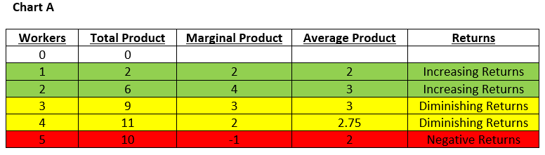

Slide 23
Total product or output -It is the output derived from all factors, both fixed and variable employed by the producer.
Trends in output
Total output goes on increasing as long as MP is positive. It is the highest when MP is zero and TP declines when MP becomes negative.
MP increases in the beginning, reaches the highest point and diminishes at the end.
AP will also have the same tendencies as the MP. In the beginning MP will be higher than AP but at the end AP will be higher than MP

Slide 24
Three phases of the law of diminishing marginal returns
Stage 1: Increasing returns- As you hire more workers you get increasing marginal product (Increasing return)- Initially, adding to one production variable is likely to improve the output as the fixed inputs are in abundance compared to the variable one. Therefore, adding more units of the variable factor will use the fixed factors more efficiently and increase production.
( the first stage comes to an end at the point where MP curve cuts the AP curve when AP is maximum )
Stage 2: Diminishing returns- As more units of the variable factor are added, the overall production will continue to increase. However, during this stage, the total product increases at a continuously decreasing rate. This process culminates with the product reaching its maximum value, meaning that the marginal product becomes zero. Optimum production is set somewhere within this stage. Adding more units of the variable factor after this point will lead to the overall output starting to diminish.
(This stage is called diminishing returns because both AP and MP of the variable factor continuously fall during this stage. It is only in this stage , the firm is maximizing its total output.)

Slide 25
Stage 3: Negative returns - Excessively adding to the variable input after the point of optimum production will eventually lead not only to a decrease in efficiency but even to a negative return of production. The excess in the variable factor now hurts the whole production process

Slide 26
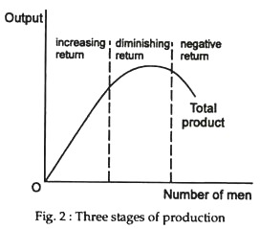

Slide 27
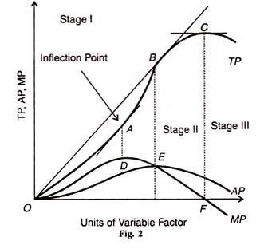
The law of variable proportions

Slide 28
Production function with two variable inputs
ISO-Quants and ISO-Cost

